Slide 1
PIP-103: PROFESSIONAL PRACTICE-III (INTERNSHIP) Review-3 Presentation Good Work Connect- Corporate Social Responsibility Web Portal
.
Submitted to the Presidency University, Bengaluru in partial fulfillment of the requirements for the PIP-103: PROFESSIONAL PRACTICE-III (INTERNSHIP)
By
Alavalapati veera bharath kumar reddy 20201COD0033
Uday Kumar S 20201COD0034
Boggadi raja reddy 20201COD0027
Dodda jagaeesh reddy 20201COD0041
Under the supervision of
Mr. Pajany M Assistant Professor Department of Computer Science & Engineering

Slide 2
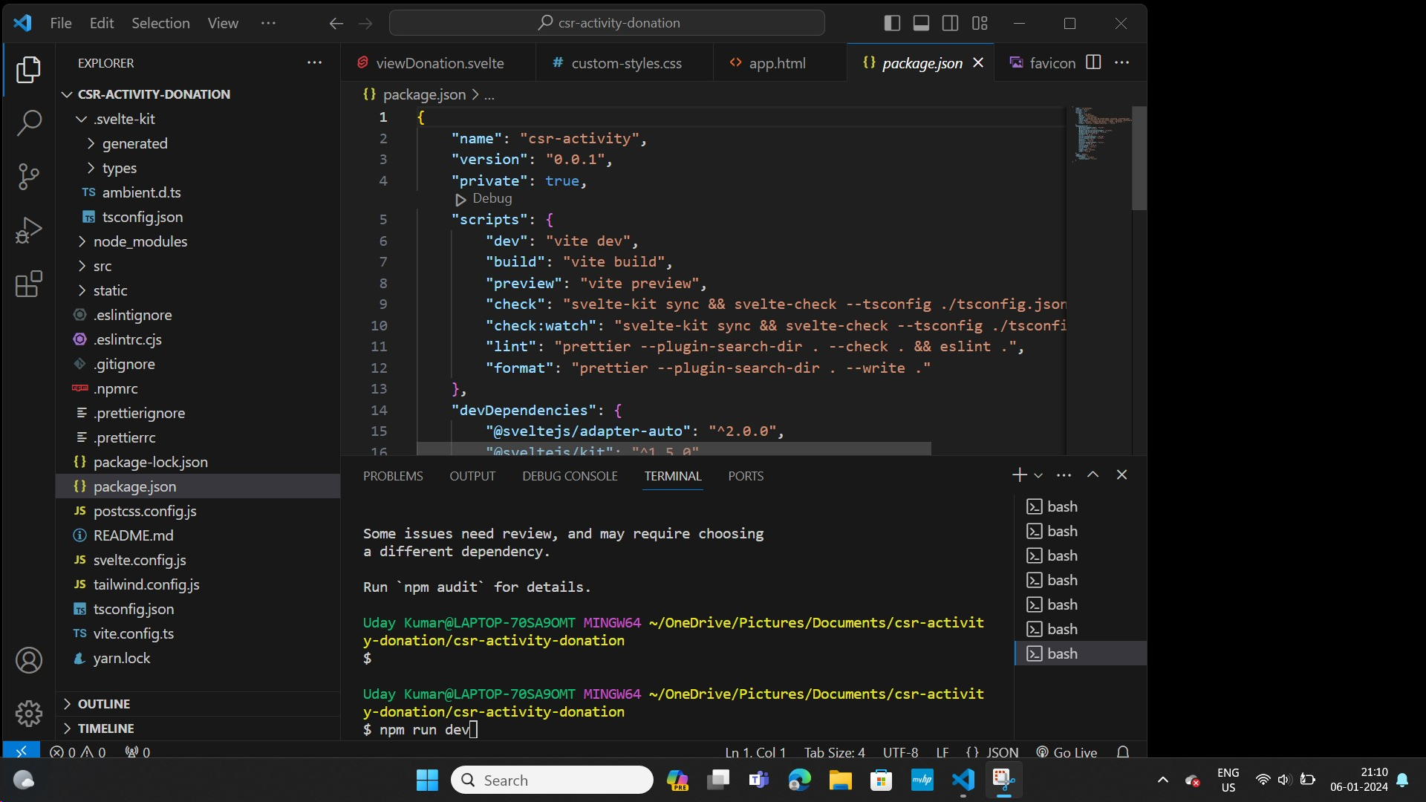
Source Code:

Slide 3
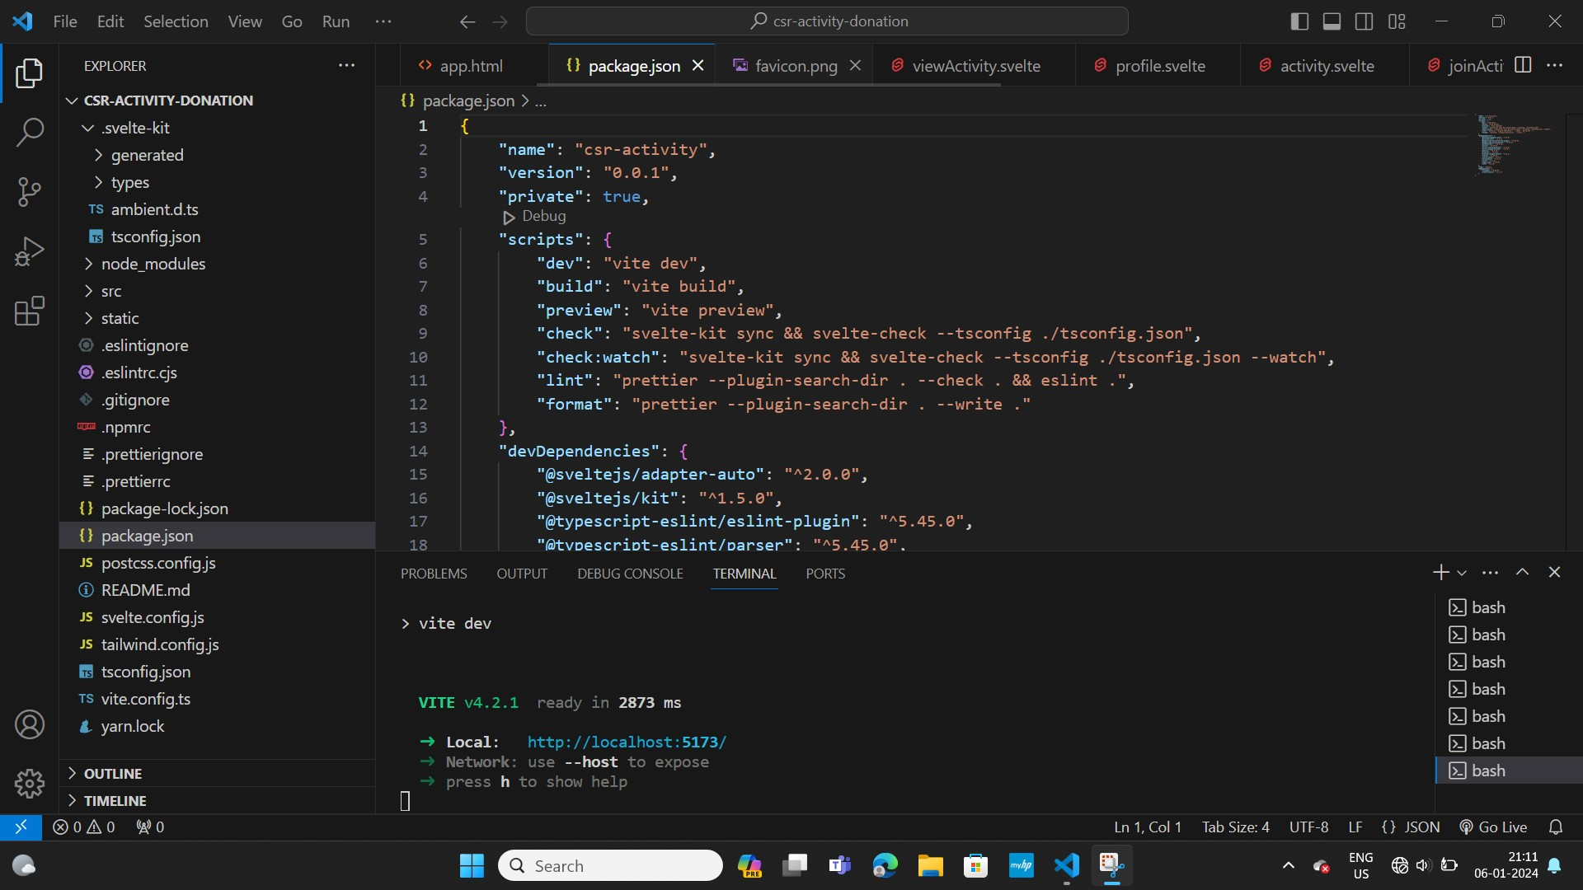

Slide 4
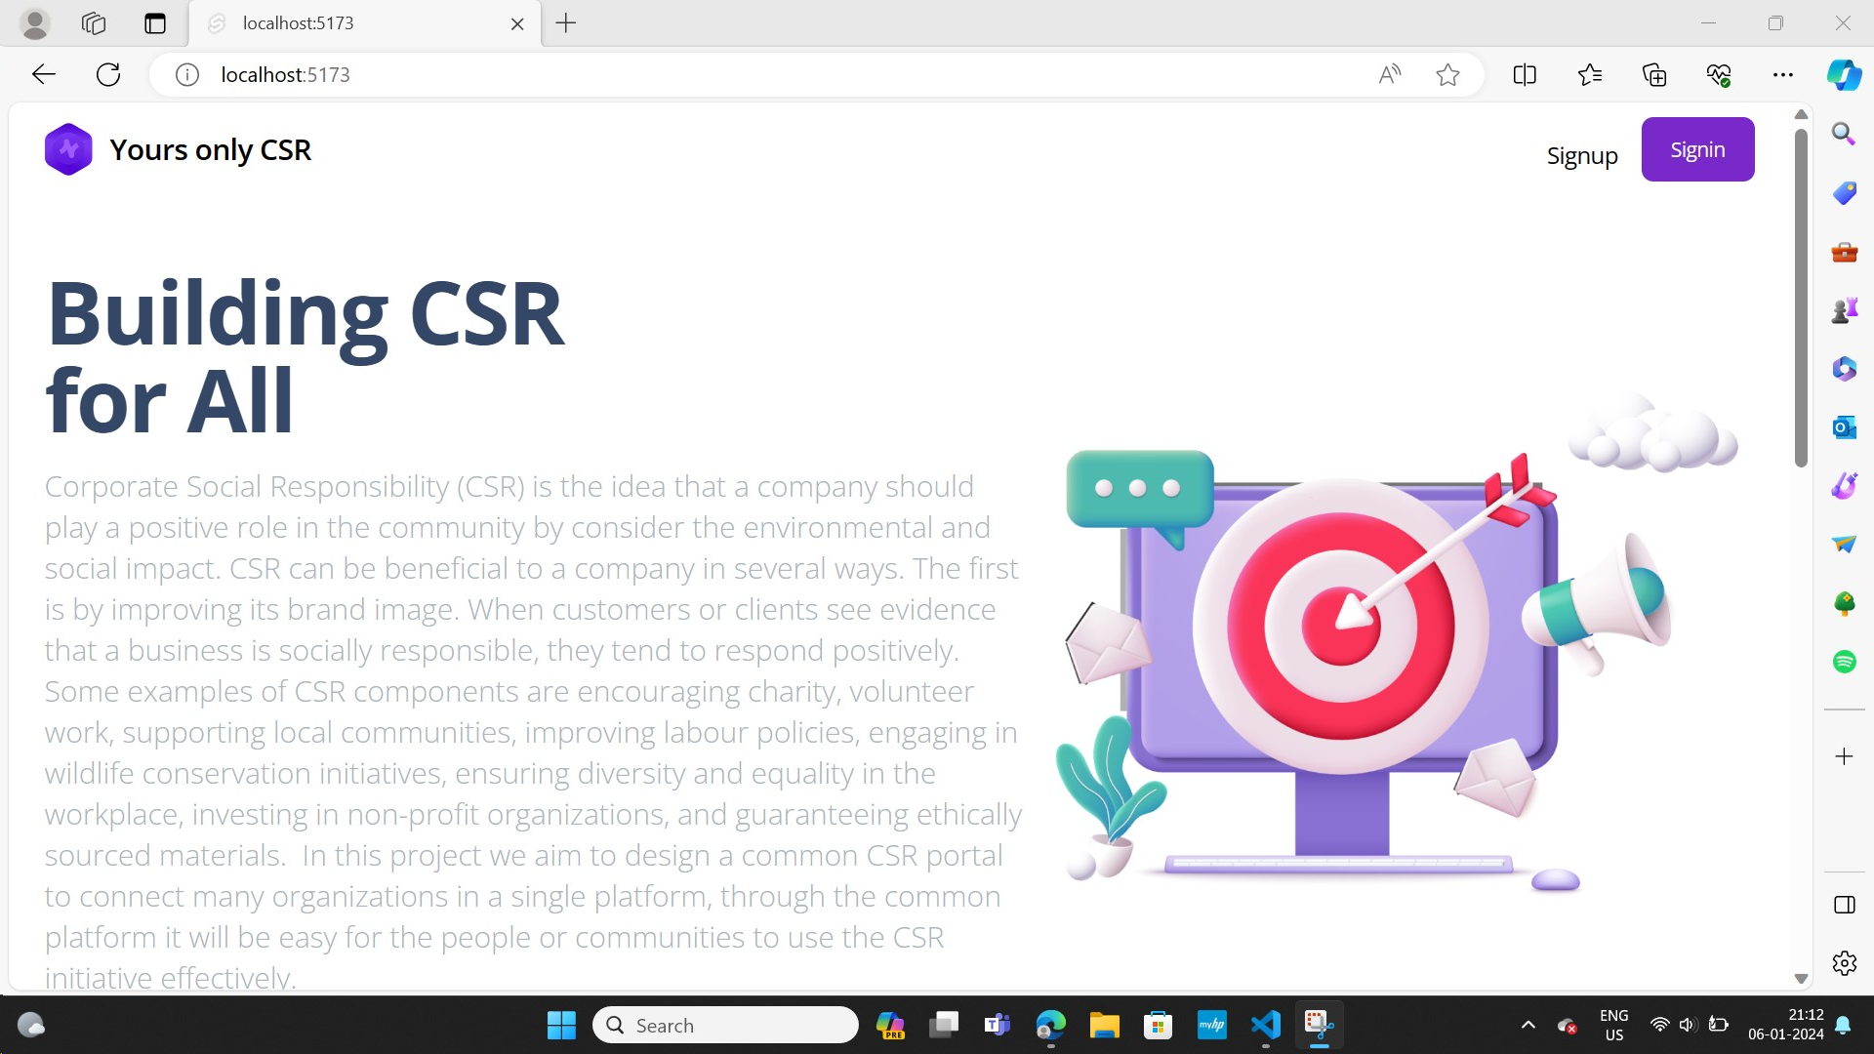

Slide 5
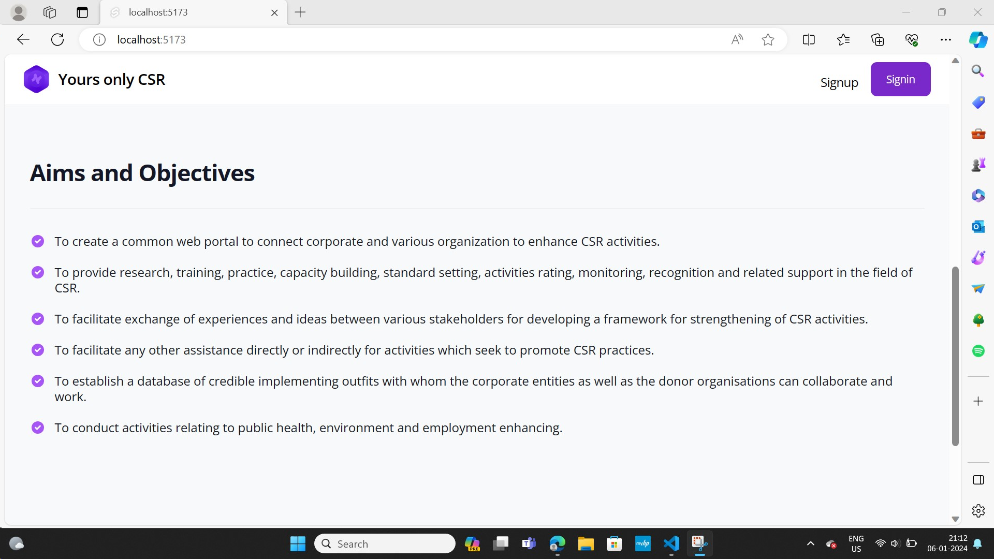

Slide 6
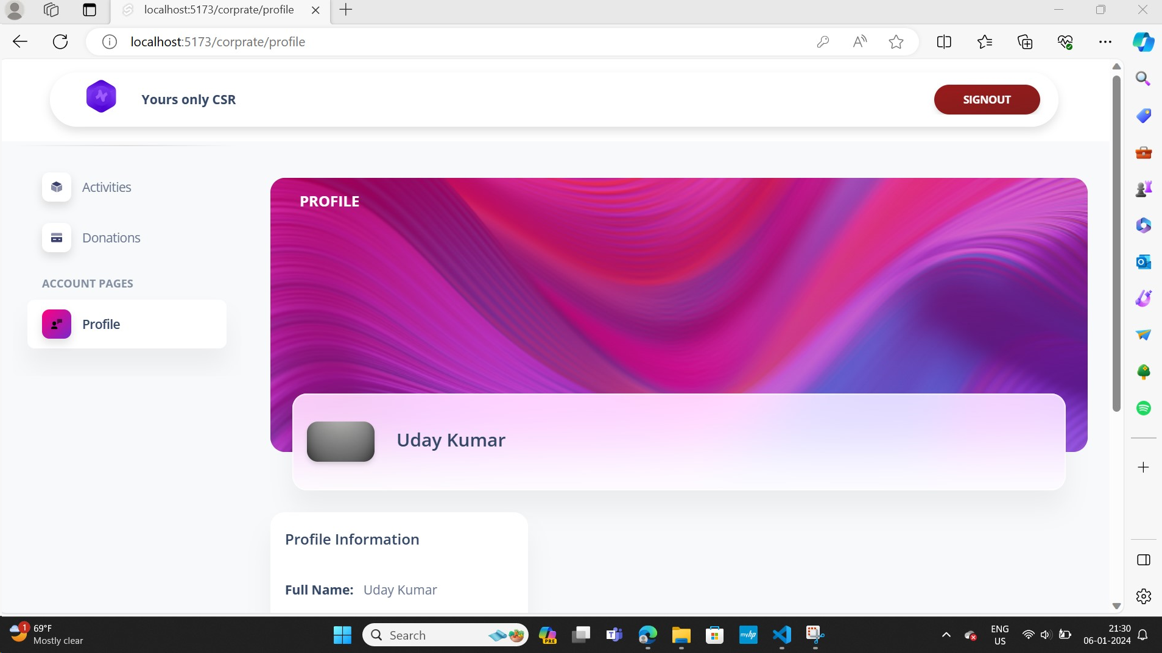

Slide 7
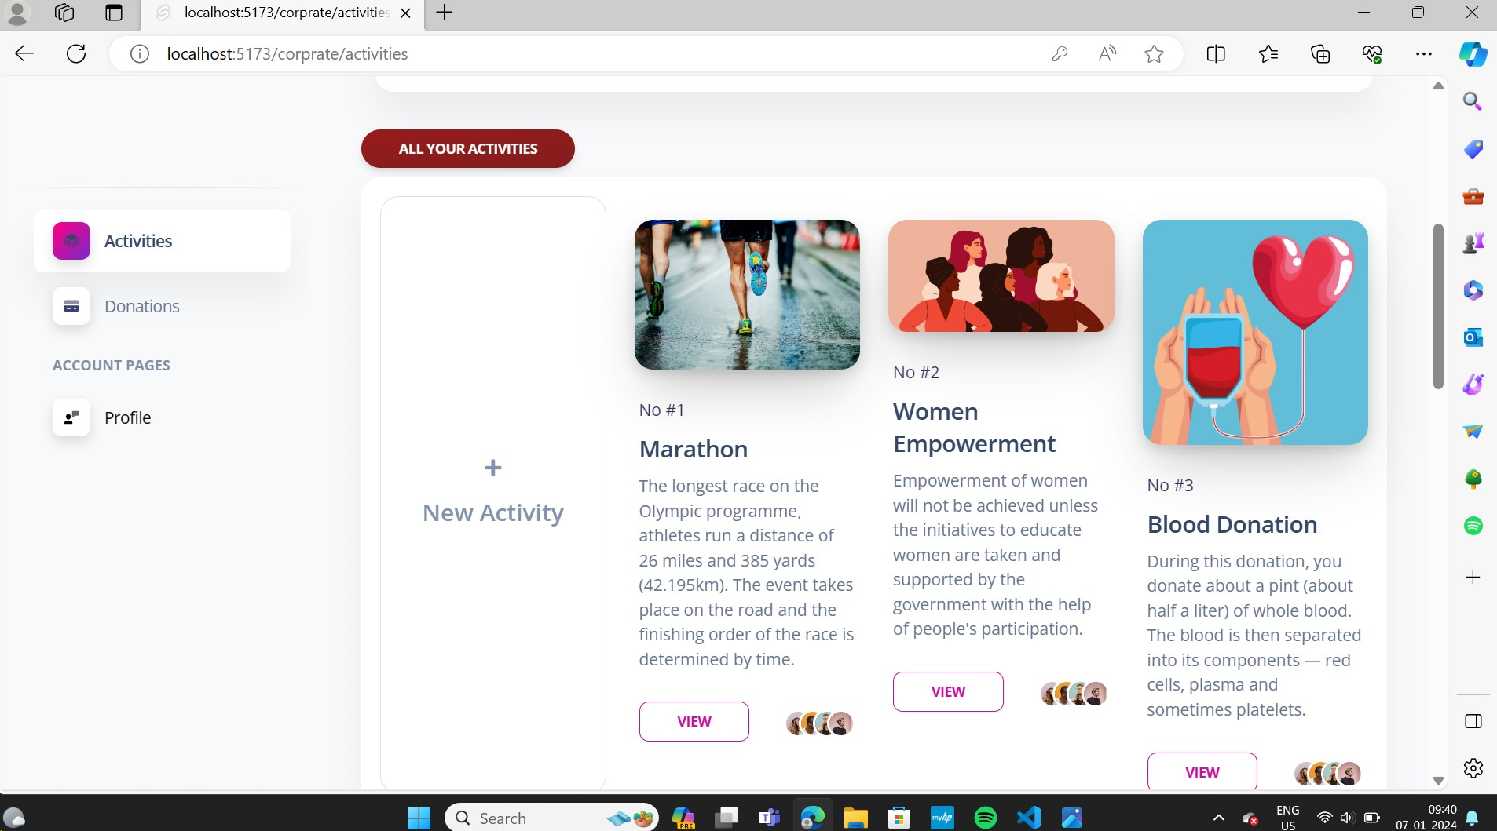

Slide 8
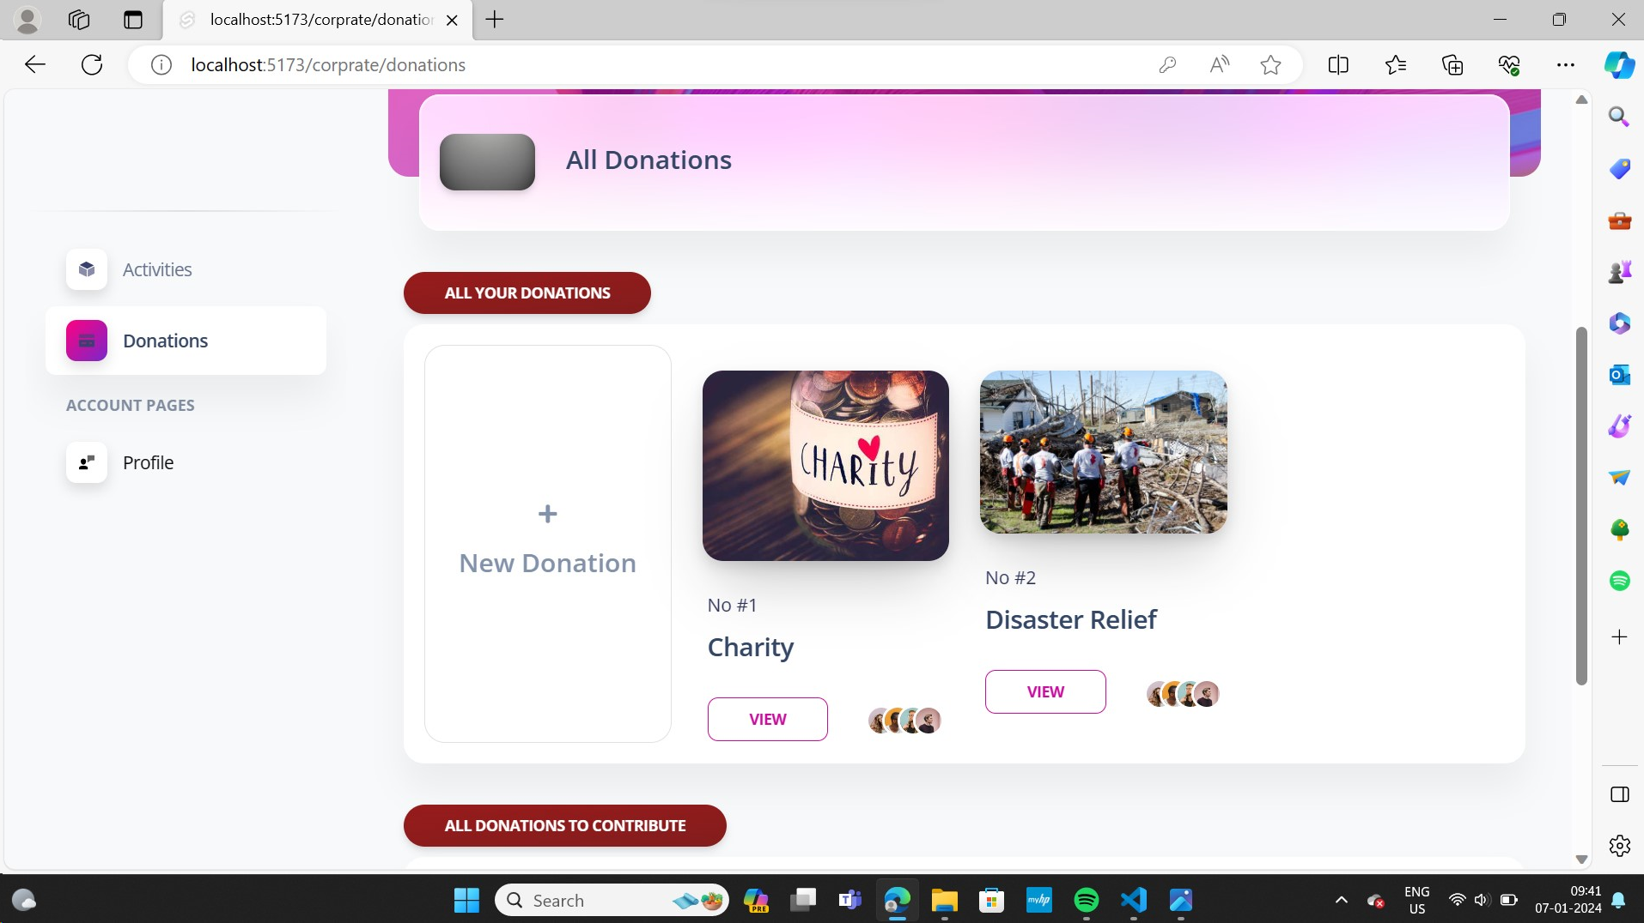

Slide 9
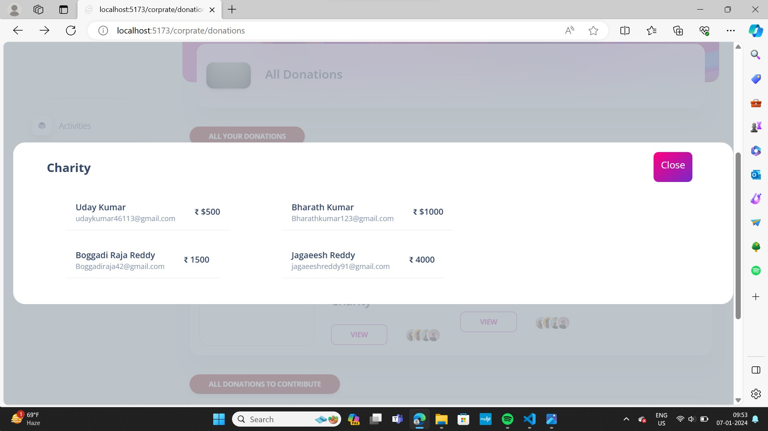

Slide 10
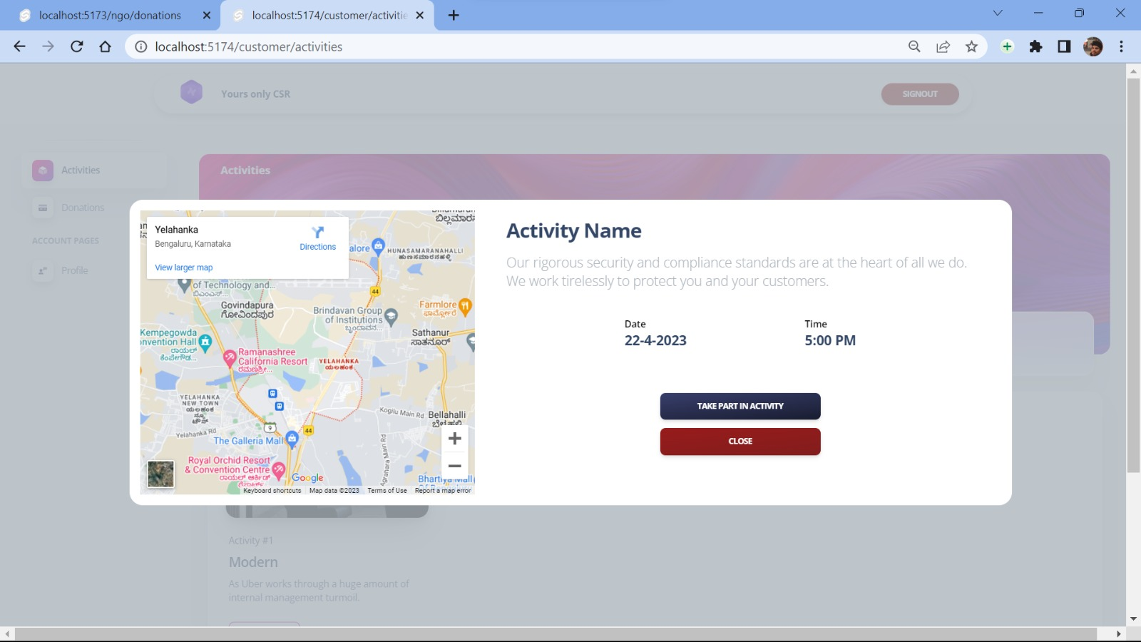

Slide 11


